Slide 1
Module 2 – Python Examples and how computers represent data in bits and bytes
Chapters 3 and 8

Slide 2
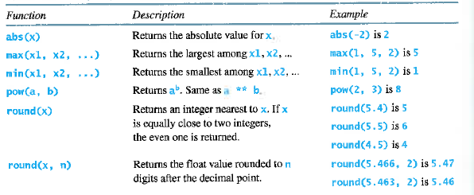
Built-in numeric functions
https://docs.python.org/2/library/functions.html
Notes:
In Python shell:
Do round function to various decimal places. Note the difference between int() and round().
In Python shell, do pow() function. Do some powers of 2, and show 2 to 8th power (=256). A byte has 8 bits, so you wind up with 256 possible values in a byte. Two bytes have 16 bits, so you get 65536 possible values.
How can you do the same thing with just operators? ** operator

Slide 3
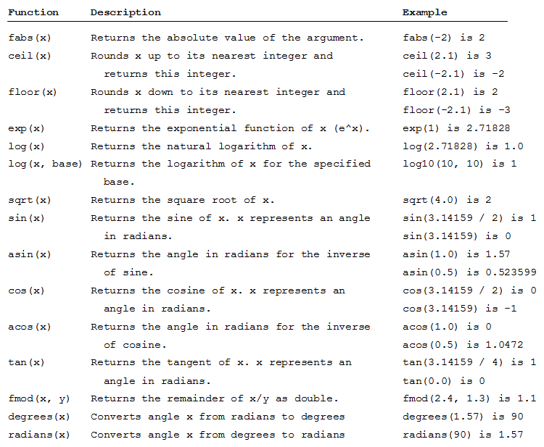
Math Module’s Functions
https://docs.python.org/2/library/math.html
Notes:
In Python shell: import math
Do sqrt() function (type math.sqrt(x). How can you do the same using ** operator (**.5)?
Do log() function using base 2 (type math.log()).
What’s the relationship between exponentiation and logarithm? (Inverse)
2⁸ = 256 log₂ 256 = 8
In python math.log(#, base)
This prepares us to discuss how RAM represents data in memory.

Slide 4
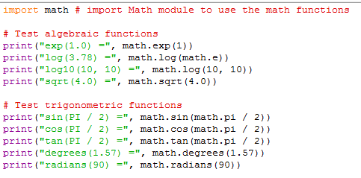
Listing 3.1 MathFunctions
Notes:
In Python shell:
Try various functions of math module.

Slide 5
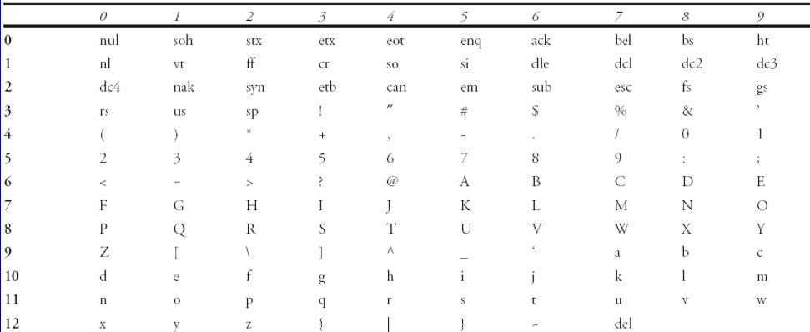
ASCII Character Set
Notes:
Ch3 discusses ASCII vs. Unicode
ASCII is an 8-bit character encoding scheme. How many different characters can you represent in 8 bits? Actually, ASCII only uses 7 bits out of the byte. So, there are 128 characters in the character set. This table shows the ASCII characters.
Each character has an ordinal value (a number that represents the character). For example, the character “a” has an ordinal value of 97.
One byte is fine for the English language. But there are many languages with many different alphabets. We need 2 bytes to handle all of these alphabets and symbols.
Unicode is a 16-bit character encoding scheme. The first 128 ordinal values are the same as ASCII’s. The rest represent other symbols beyond what ASCII provides. Python represents all characters using Unicode notation, so it can represent all of the earth’s alphabets.
The chr() and ord() functions can help illustrate this.
In Python shell, do these function calls:
chr(97)
ord("a")
Do the same for capital letter A
Try a few big ordinal numbers to see the symbols they display (Unicode stuff)

Slide 6
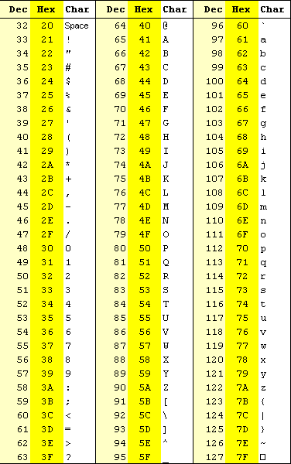

Slide 7
Binary representation of the character “a”
Two bytes (Unicode)
One byte (ASCII)
0 0 0 0 0 0 0 0 0 1 1 0 0 0 0 1
2¹⁵ 2¹⁴ 2¹³ 2¹² 2¹¹ 2¹⁰ 2⁹ 2⁸ 2⁷ 2⁶ 2⁵ 2⁴ 2³ 2² 2¹ 2⁰
2⁰ + 2⁵ + 2⁶ = 1 + 32 + 64 = 97
Notes:
In Python shell, type this command:
format(ord('a'),'b')
This returns a string showing the ordinal value of the letter a in binary format. Thus, you can see the bits of the letter’s Unicode value. This is what will be in memory.
The format function takes two argument, the data itself and a string indicating the format specification.
In this case we pass a number as the data: result of ord('a'), which is 97.
The second argument is 'b', which specifies the format should be a binary representation. (o = octal 141 & x = hexadecimal 61)
We’ll see other uses of the format function later.

Slide 8
From Listing 3.3 DisplayUnicode
escape sequence
hexadecimal Unicode representation
https://unicode-table.com/en/#cjk-unified-ideographs
Notes:
The print statement prints six Unicode characters. In a literal string, a backslash \ is called an escape character. \u is an escape sequence, followed by the four hexadecimal digits that represent the character in Unicode. Each hexadecimal digit is four bits long, so four hexadecimal digits is equal to 16 binary digits (bits). That’s 2 bytes, the size of a Unicode character.
More about escape sequences later.
In Python shell:
ord('欢') = 27426 decimal (base 10)
format(ord('欢'),'x') = 6b22 hexadecimal (base 16)
format(ord('欢'),'b') = 110101100100010 binary(base 2)
chr(27426) = 欢

Slide 9
Binary representation of the character “欢”
Two bytes (Unicode)
One byte (ASCII)
0 1 1 0 1 0 1 1 0 0 1 0 0 0 1 0
2¹⁵ 2¹⁴ 2¹³ 2¹² 2¹¹ 2¹⁰ 2⁹ 2⁸ 2⁷ 2⁶ 2⁵ 2⁴ 2³ 2² 2¹ 2⁰
2¹ + 2⁵ + 2⁸ + 2⁹ + 2¹¹ + 2¹³ + 2¹⁴
= 2 + 32 + 256 + 512 + 2048 + 8192 + 16384
= 27426

Slide 10
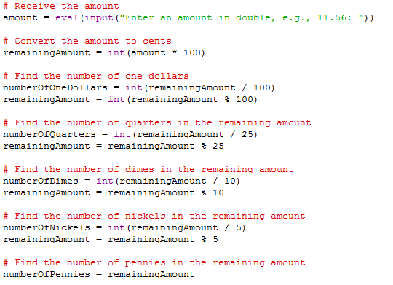
Listing 3.4 ComputeChange
Notes:
Similar techniques can be used to solve different (but similar) problems. Here we use integer division and remainder to separate the total into dollars, quarters, dimes, nickel, and pennies. We saw this a few times before:
e.g. (Ch2 Listing 2.7, Exercise 1.11)
With Python:
Review Ch2 Listing 2.7 ShowCurrentTime (hours/minutes/seconds) and Exercise 1.11 solution (births/deaths/immigrations)

Slide 11
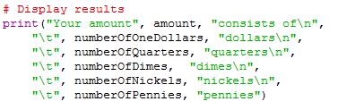
Listing 3.4 ComputeChange
Notes:
Here we see another use of escape sequences. Again, note the \ as the escape character.
\n means go to the next line
\t means tab
With Python: Run the program to see the effects.

Slide 12
Escape Sequences
Description Escape Sequence Unicode
Backspace \b \u0008
Tab \t \u0009
Linefeed \n \u000A
Carriage return \r \u000D
Backslash \\ \u005C
Single Quote \' \u0027
Double Quote \" \u0022
Notes:
In Python Shell:
Do examples of print statements using strings with various escape sequences.

Slide 13
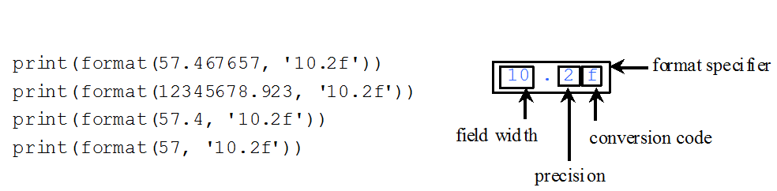
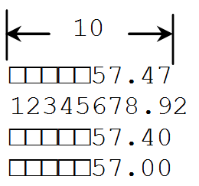
format function for numeric data
Notes:
The textbook shows other kinds of formatting (percentage, scientific notation, decimal/hex/binary/decimal, justification).
In Python Shell:
Try various formats for numeric data.

Slide 14
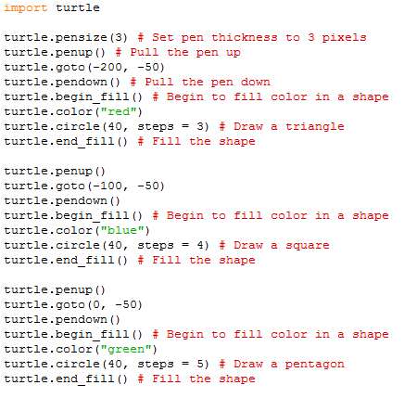
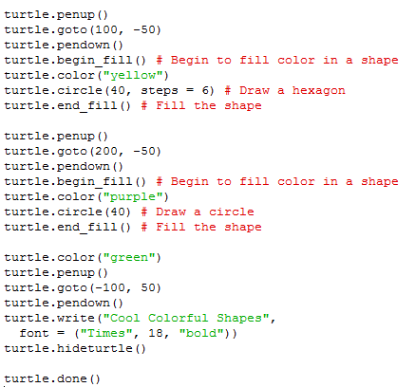
Listing 3.6 ColorShapes
Notes:
New turtle features:
Setting the color of the pen
Using circle to create 3-sided, 4-sided, 5-sided, …. N-sided shapes.
Use of named arguments
steps (in circle function)
font (in write function)
With Python: try bigger numbers for the steps argument to see what kind of shape you get. Try different fonts.

Slide 15
Introduction to Objects and Methods
In Python, all data—including numbers and strings—are objects.
An object is an entity
Each object has an id and a type
Objects of the same kind have the same type
Use the id function and type function to get these information for an object

Slide 16
Object Types and Ids
The id and type functions are rarely used in programming, but they are good pedagogical tools for understanding objects.
>>> n = 3 # n is an integer
>>> id(n)
505408904
>>> type(n)
<class ’int’>
>>> f = 3.0 # f is a float
>>> id(f)
>>> 26647120
>>> type(f)
<class ’float’>
>>> s = "Welcome" # s is a string
>>> id(s)
36201472
>>> type(s)
<class ’str’>

Slide 17
Variables and Objects
We have an int object, a float object, and a str object. The variables n, f, and s are references to the actual objects; variables point to these objects.

Slide 18
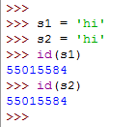

Variables and Objects (str)
Sometimes two different variables can be pointing at the same object:
a string object
id:
value:
This object is an instance of the str class
Notes:
There is only one string object with value ‘hi’, even though you see it twice in the code. Variables s1 and s2 both point at the same object.
Objects are instances of classes. A class is a category of things. An instance is one of those things.
Most of the built-in Python classes are immutable. This means their contents can’t change once they are instantiated (created). There are some Python classes that are mutable; these are mostly collections like lists. We’ll talk more about lists later in the semester.

Slide 19
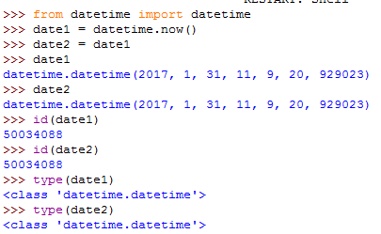
Variables and Objects (datetime)
Sometimes two different variables can be pointing at the same object:
a datetime object
id:
year:
2017
month:
1
This object is an instance of the datetime class
day:
31
hour:
11
minute:
9
second:
20
microsecond:
929023
https://docs.python.org/2/library/datetime.html
Notes:
Like most of the built-in Python classes, datetime objects are immutable.
Objects have attributes and methods.
Each of the attributes are really themselves pointers to objects of certain types. For example, the year attribute points to another object of type int.
A datetime object has a number of attributes, including those shown here.
In Python shell:
Create date1 and date2 using now function.
See values, ids, and types of datetime attributes.
Try different datetime methods for date1 and date2.
Change date2 to show that now we have a different object.
Formatting date: use strftime method. See formatting examples in web page documentation.

